Slide 1
K-Means
Session 23
Felix Indra Kurniadi, S.Kom., M.Kom.

Slide 2
Learning Outcomes
Session 23
At the end of this session, students will be able to:
LO 5: Apply various learning algorithms for agents to solve problems

Slide 3
outline
Session 23
Clustering
K-Means Clustering

Slide 4
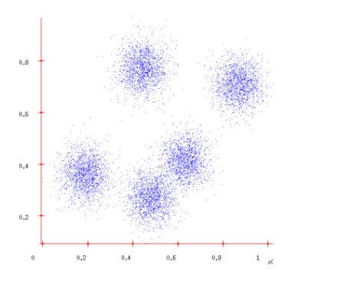
Clustering
Definition
Sometimes the data form clusters, where examples within a cluster are similar to each other, and examples in different clusters are dissimilar
Grouping data points into clusters, with no labels, is called clustering

Slide 5
clustering
definition
So, what is the clustering in General:
  Select and Employ an Appropriate Similarity/Dissimilarity Function
  The algorithm figures out the grouping of objects based on the chosen similarity/ dissimilarity function
  Points within a cluster is similar
  Points across cluster are not so similar

Slide 6
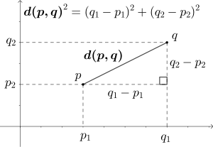
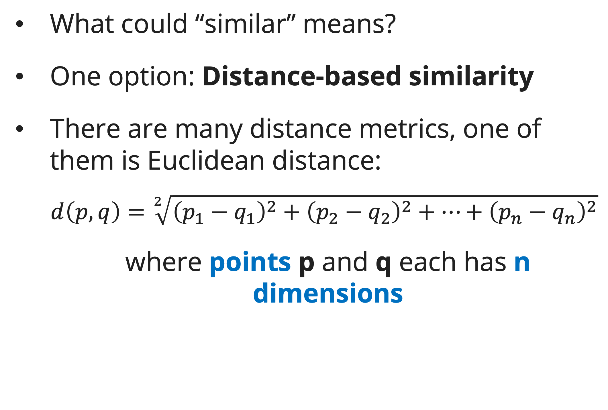
clustering
definition
What could “similar” means?
One option: Distance-based similarity
There are many distance metrics, one of them is Euclidean distance:
  $$d\left(p, q\right)=\sqrt[2]{{\left(p_{1}−q_{1}\right)}^{2}+{\left(p_{2}−q_{2}\right)}^{2}+…+{\left(p_{n}−q_{n}\right)}^{2}}$$
  where points p and q each has n dimensions
Fig. Example of Euclidean distance where n = 2

Slide 7
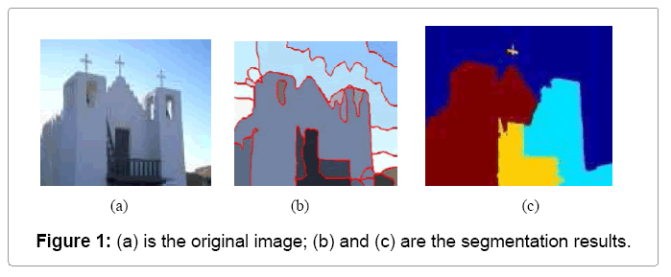
Clustering
applications
Image Segmentation
Goal: Break up the image into meaningful or perceptually similar regions
Source image: https://www.kdnuggets.com/2019/08/introduction-image-segmentation-k-means-clustering.html

Slide 8
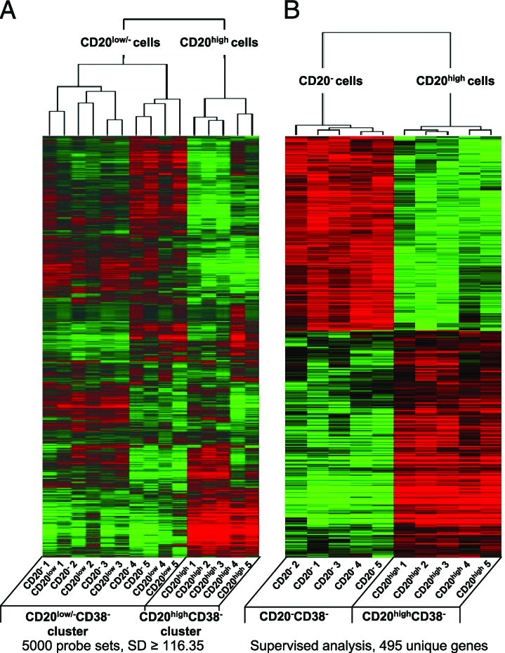
Clustering
applications
Clustering gene expression data
Source image: https://www.researchgate.net/figure/Unsupervised-and-supervised-clustering-of-gene-expression-profiles-of-purified-D4-CD20_fig4_51643539

Slide 9
K-Means clustering
definition
K-Means (MacQueen’67, Lloyd’57/’82)
  Each cluster is represented by the center of the cluster (centroid)
Given K, the number of clusters, the clustering algorithm is outlined as follows
    Select random K points as initial centroids
    Repeat:
      Form K clusters by assigning each point to its closest centroid
      Re-compute the centroids (i.e., mean point) of each cluster
    Until convergence criterion is satisfied
Different kinds of measures can be used
  Manhattan distance (L1 norm), Euclidean distance (L2 norm), Cosine similarity

Slide 10
K-Means clustering
Visual example

Slide 11
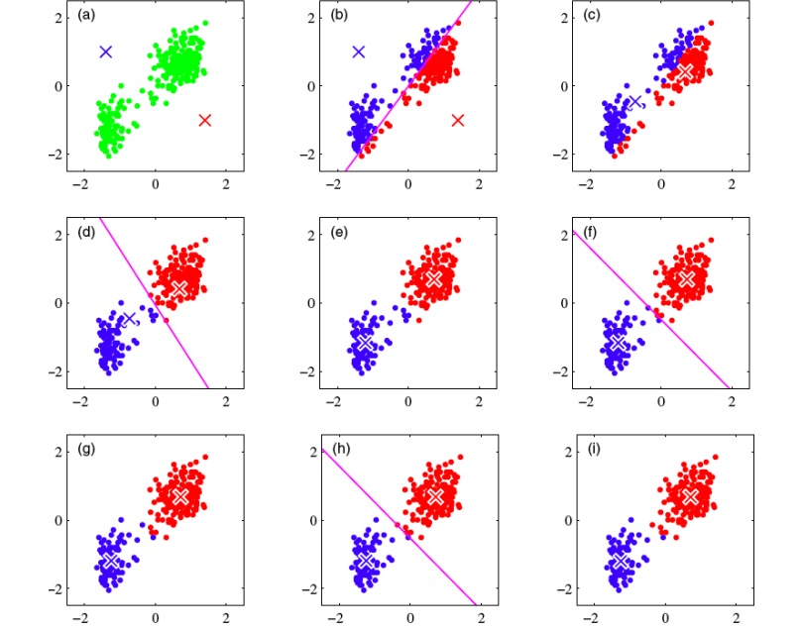
K-Means clustering
Visual example

Slide 12
K-means clustering
Calculation example
We will calculate K-Means clustering using this dataset which has 7 points of data with 2 dimensions.
We use K = 2, which means there will be 2 clusters

Slide 13
K-means clustering
Assigning random centroid
Choose random K centroid for initialization.
In this example, data 1 and 4 are chosen to be the centroid.
Therefore, Centroid 1 = (1, 1) and Centroid 2 = (5, 7)
Centroids can be any point, doesn’t have to be from any data points available.

Slide 14
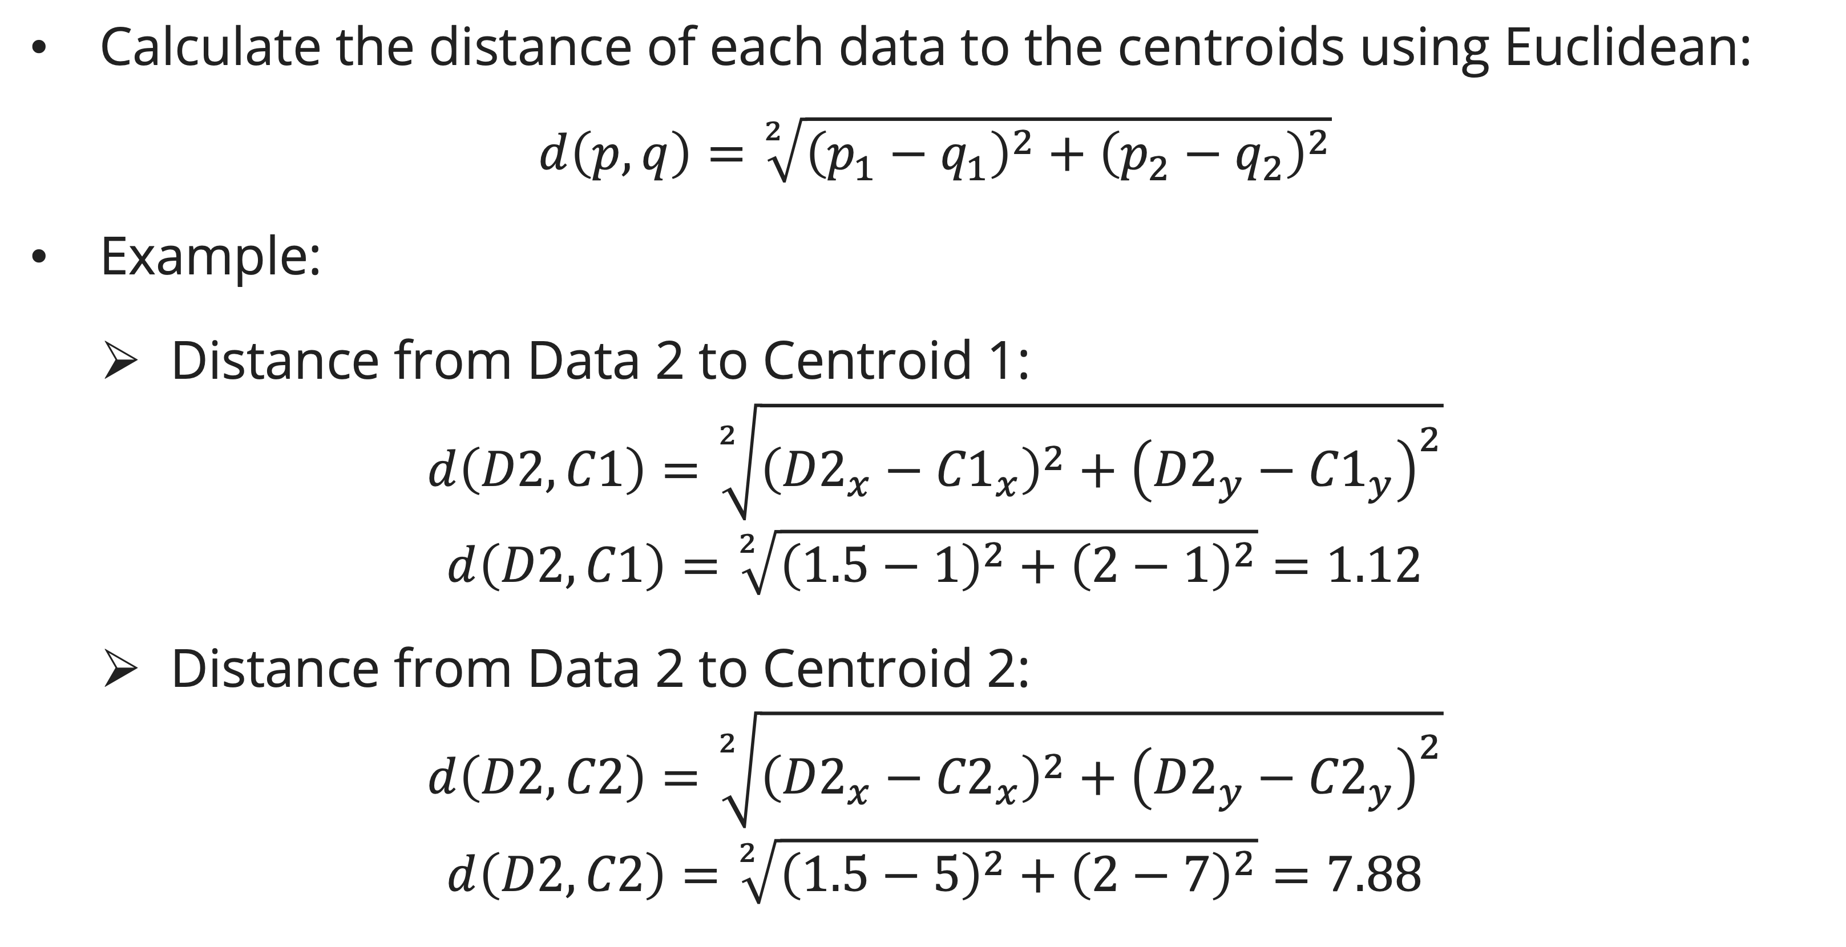
K-means clustering
Iteration 1: Assign each point to closest centroid
Calculate the distance of each data to the centroids using Euclidean:
$$d\left(p, q\right)=\sqrt[2]{{\left(p_{1}−q_{1}\right)}^{2}+{\left(p_{2}−q_{2}\right)}^{2}}$$
Example:
  Distance from Data 2 to Centroid 1:
$$d\left(D2, C1\right)=\sqrt[2]{{\left({D2}_{x}−{C1}_{x}\right)}^{2}+{\left({D2}_{y}−{C1}_{y}\right)}^{2}}$$
$$d\left(D2, C1\right)=\sqrt[2]{{\left(1.5−1\right)}^{2}+{\left(2−1\right)}^{2}}=1.12$$
  Distance from Data 2 to Centroid 2:
$$d\left(D2, C2\right)=\sqrt[2]{{\left({D2}_{x}−{C2}_{x}\right)}^{2}+{\left({D2}_{y}−{C2}_{y}\right)}^{2}}$$
$$d\left(D2, C2\right)=\sqrt[2]{{\left(1.5−5\right)}^{2}+{\left(2−7\right)}^{2}}=7.88$$

Slide 15
K-means clustering
Iteration 1: Assign each point to closest centroid

Slide 16
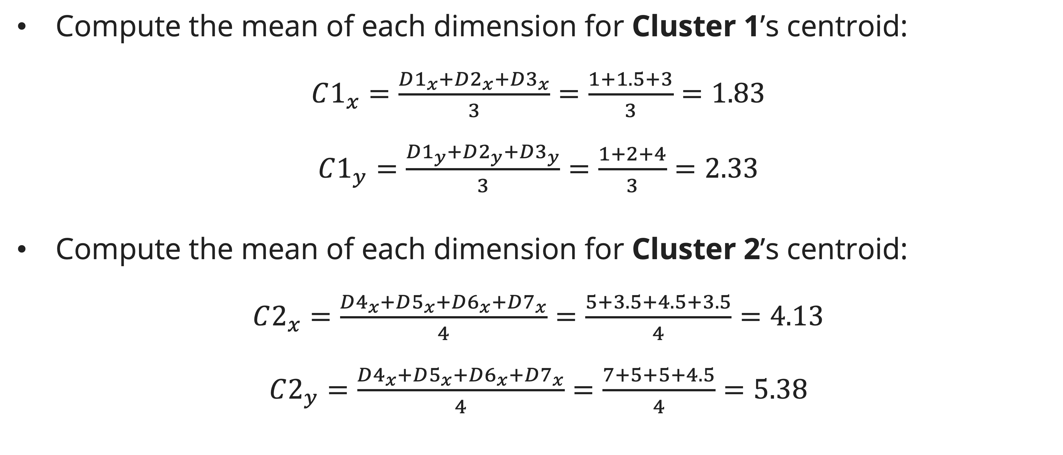
K-means clustering
Iteration 1: Re-compute the centroid (mean)
Compute the mean of each dimension for Cluster 1’s centroid:
$C1_{x}=\frac{D1_{x}+D2_{x}+D3_{x}}{3}=\frac{1+1.5+3}{3}=1.83$
$C1_{y}=\frac{D1_{y}+D2_{y}+D3_{y}}{3}=\frac{1+2+4}{3}=2.33$
Compute the mean of each dimension for Cluster 2’s centroid:
$C2_{x}=\frac{D4_{x}+D5_{x}+D6_{x}+D7_{x}}{4}=\frac{5+3.5+4.5+3.5}{4}=4.13$
$C2_{y}=\frac{D4_{x}+D5_{x}+D6_{x}+D7_{x}}{4}=\frac{7+5+5+4.5}{4}=5.38$

Slide 17
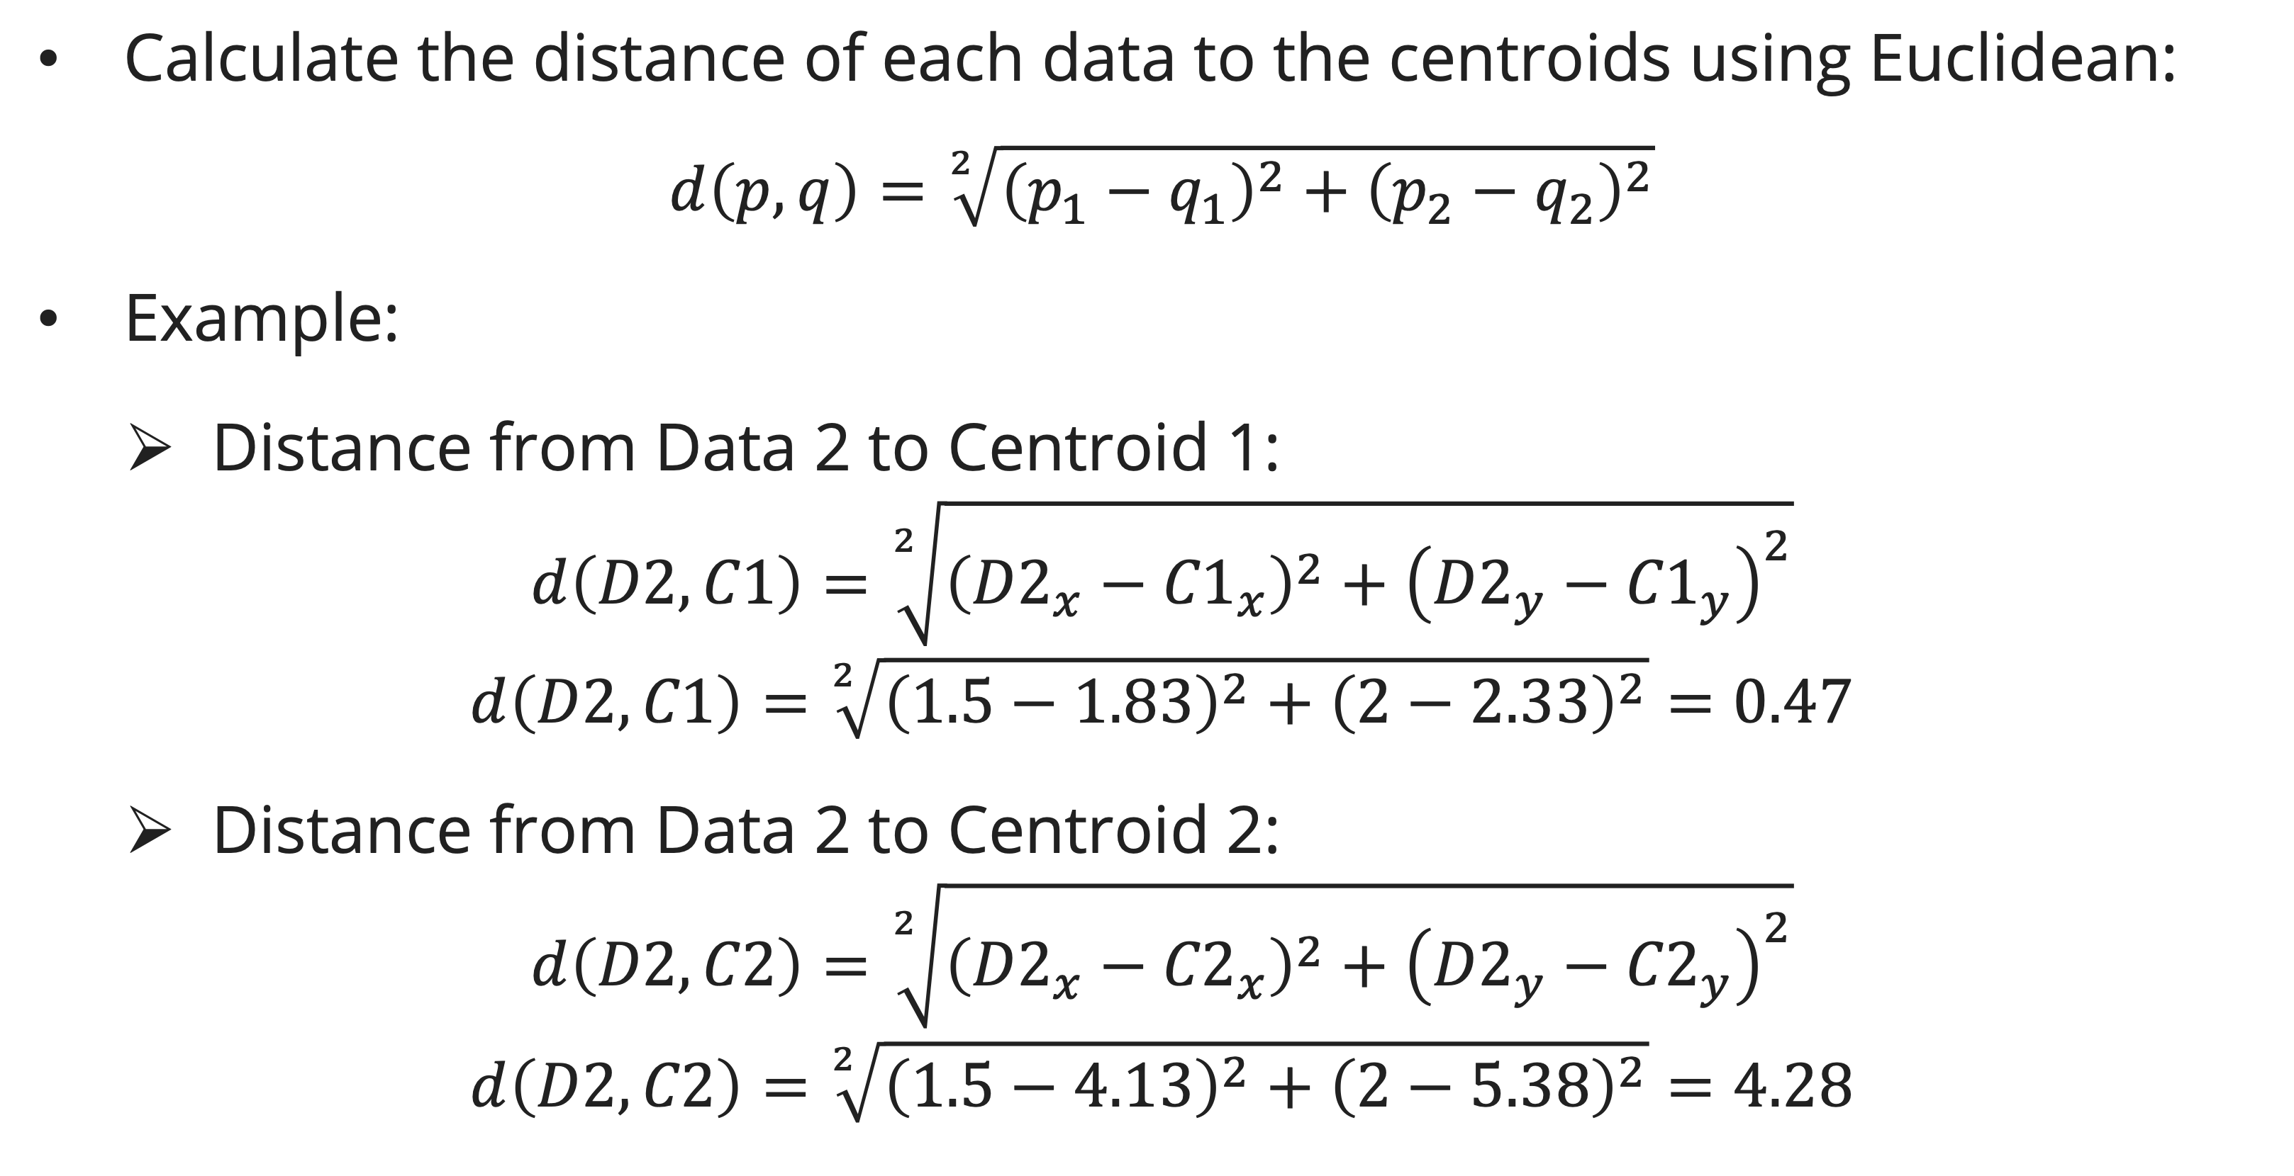
K-means clustering
Iteration 2: Assign each point to closest centroid
Calculate the distance of each data to the centroids using Euclidean:
$$d\left(p, q\right)=\sqrt[2]{{\left(p_{1}−q_{1}\right)}^{2}+{\left(p_{2}−q_{2}\right)}^{2}}$$
Example:
  Distance from Data 2 to Centroid 1:
$$d\left(D2, C1\right)=\sqrt[2]{{\left({D2}_{x}−{C1}_{x}\right)}^{2}+{\left({D2}_{y}−{C1}_{y}\right)}^{2}}$$
$$d\left(D2, C1\right)=\sqrt[2]{{\left(1.5−1.83\right)}^{2}+{\left(2−2.33\right)}^{2}}=0.47$$
  Distance from Data 2 to Centroid 2:
$$d\left(D2, C2\right)=\sqrt[2]{{\left({D2}_{x}−{C2}_{x}\right)}^{2}+{\left({D2}_{y}−{C2}_{y}\right)}^{2}}$$
$$d\left(D2, C2\right)=\sqrt[2]{{\left(1.5−4.13\right)}^{2}+{\left(2−5.38\right)}^{2}}=4.28$$

Slide 18
K-means clustering
Iteration 2: Assign each point to closest centroid

Slide 19
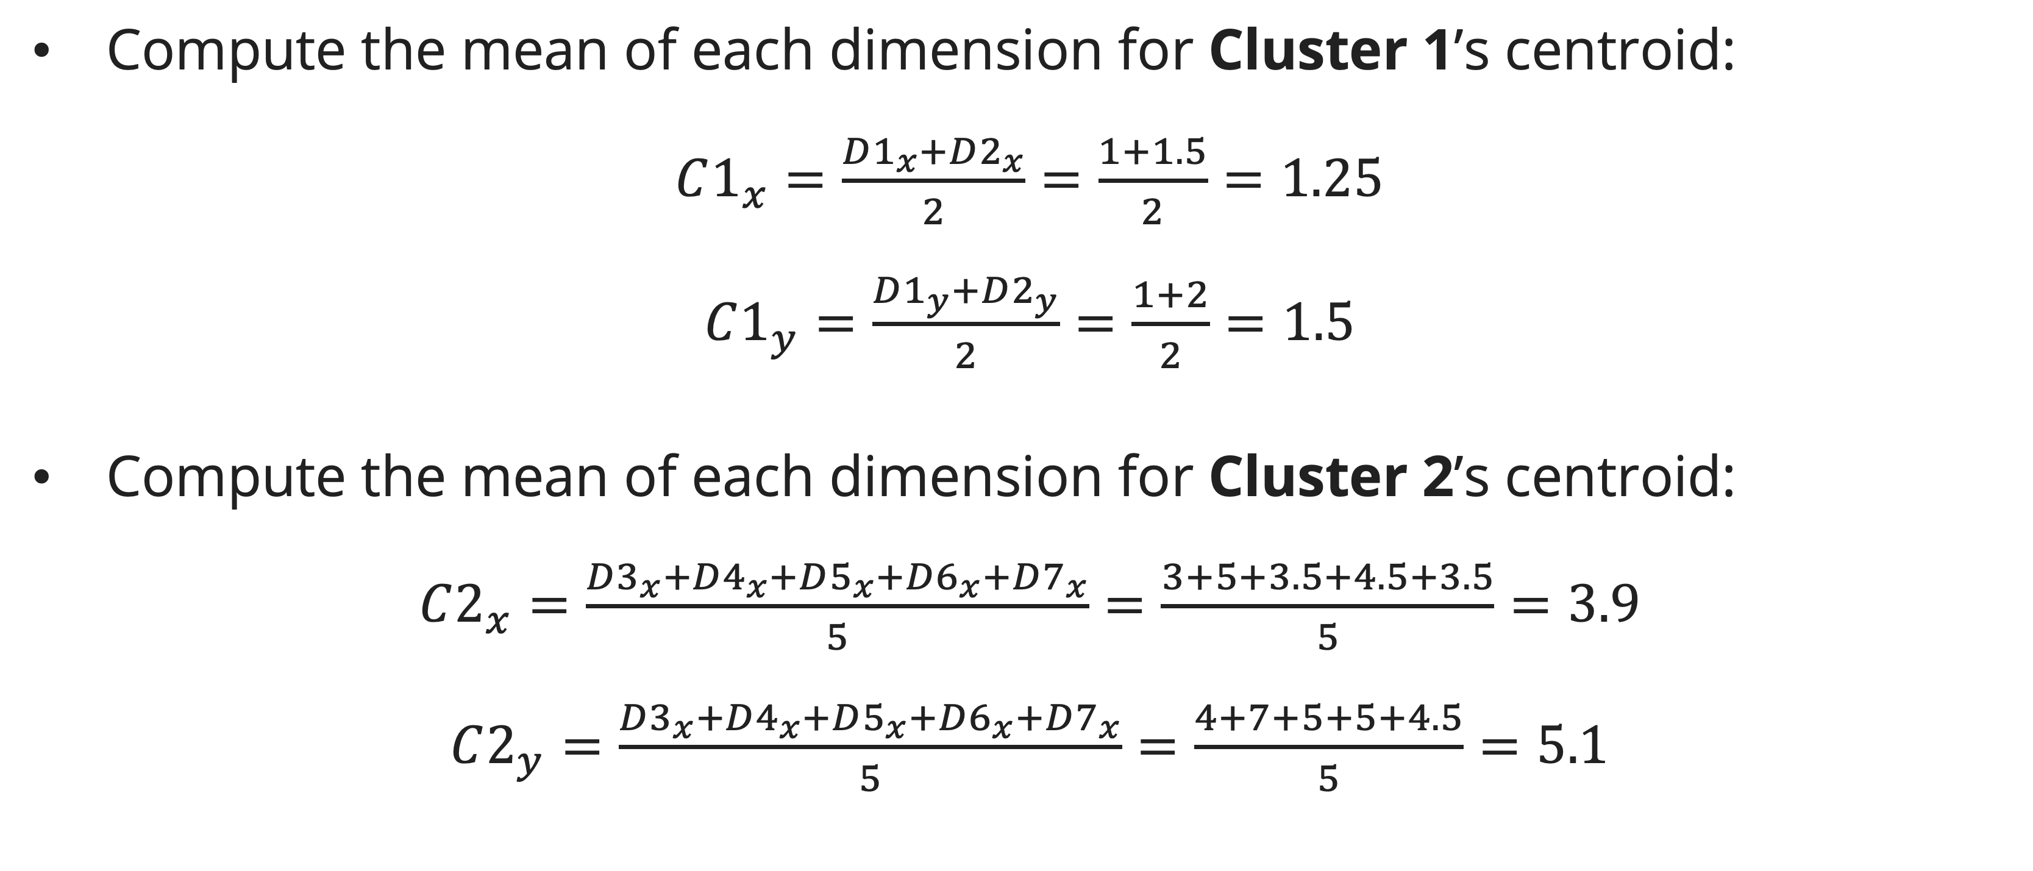
K-means clustering
Iteration 2: Re-compute the centroid (mean)
Compute the mean of each dimension for Cluster 1’s centroid:
$C1_{x}=\frac{D1_{x}+D2_{x}}{2}=\frac{1+1.5}{2}=1.25$
$C1_{y}=\frac{D1_{y}+D2_{y}}{2}=\frac{1+2}{2}=1.5$
Compute the mean of each dimension for Cluster 2’s centroid:
$C2_{x}=\frac{D3_{x}+D4_{x}+D5_{x}+D6_{x}+D7_{x}}{5}=\frac{3+5+3.5+4.5+3.5}{5}=3.9$
$C2_{y}=\frac{D3_{x}+D4_{x}+D5_{x}+D6_{x}+D7_{x}}{5}=\frac{4+7+5+5+4.5}{5}=5.1$

Slide 20
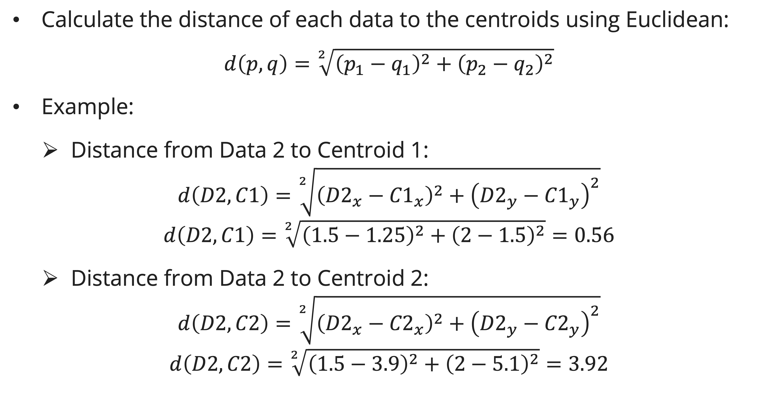
K-means clustering
Iteration 3: Assign each point to closest centroid
Calculate the distance of each data to the centroids using Euclidean:
$$d\left(p, q\right)=\sqrt[2]{{\left(p_{1}−q_{1}\right)}^{2}+{\left(p_{2}−q_{2}\right)}^{2}}$$
Example:
  Distance from Data 2 to Centroid 1:
$$d\left(D2, C1\right)=\sqrt[2]{{\left({D2}_{x}−{C1}_{x}\right)}^{2}+{\left({D2}_{y}−{C1}_{y}\right)}^{2}}$$
$$d\left(D2, C1\right)=\sqrt[2]{{\left(1.5−1.25\right)}^{2}+{\left(2−1.5\right)}^{2}}=0.56$$
  Distance from Data 2 to Centroid 2:
$$d\left(D2, C2\right)=\sqrt[2]{{\left({D2}_{x}−{C2}_{x}\right)}^{2}+{\left({D2}_{y}−{C2}_{y}\right)}^{2}}$$
$$d\left(D2, C2\right)=\sqrt[2]{{\left(1.5−3.9\right)}^{2}+{\left(2−5.1\right)}^{2}}=3.92$$

Slide 21
K-means clustering
Iteration 3: Assign each point to closest centroid

Slide 22
K-means clustering
Iteration 3
There is no change in the cluster members from iteration 2.
Thus, the algorithm comes to a halt here and the result consist of 2 clusters:
  Cluster 1: {1, 2}
  Cluster 2: {3, 4, 5, 6, 7}

Slide 23
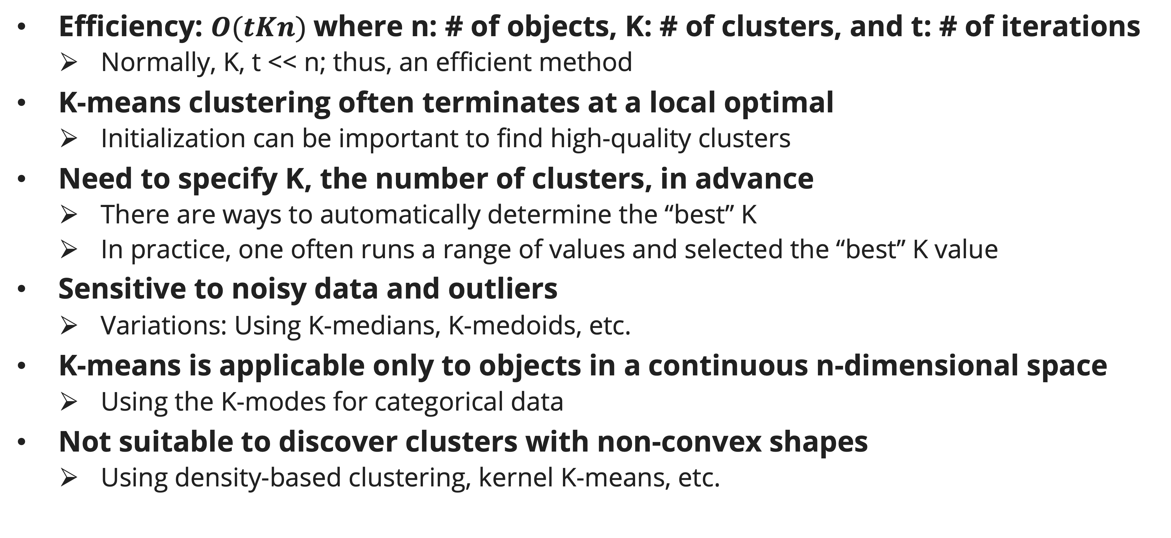
K-means clustering
discussion
Efficiency: $O(tKn)$where n: # of objects, K: # of clusters, and t: # of iterations
  Normally, K, t << n; thus, an efficient method
K-means clustering often terminates at a local optimal
  Initialization can be important to find high-quality clusters
Need to specify K, the number of clusters, in advance
  There are ways to automatically determine the “best” K
  In practice, one often runs a range of values and selected the “best” K value
Sensitive to noisy data and outliers
  Variations: Using K-medians, K-medoids, etc.
K-means is applicable only to objects in a continuous n-dimensional space
  Using the K-modes for categorical data
Not suitable to discover clusters with non-convex shapes
  Using density-based clustering, kernel K-means, etc.

Slide 24
K-Means clustering
discussion: Poor Initialization May Lead to Poor Clustering

Slide 25
Exercise
K-Means Clustering
A department store in Jakarta area, would want to make sure that their sale campaigns are right on target. In order to do that, they have to cluster their customers based on total item bought and arrival frequency.
You are asked to cluster the customer into 3 clusters (K = 3).
The initial centroids are: (2, 10), (5, 8), and (1, 2)

Slide 26
References
Session 23
Bishop, C. M. (2006). Pattern recognition and machine learning. Springer.
Grosse, R., Farahmand, A., & Carrasquilla, J. (2018). K-Means Clustering. CSC 411 Fall 2018 Machine Learning and Data Mining. https://www.cs.toronto.edu/~rgrosse/courses/csc411_f18/slides/lec15-slides.pdf
James, G., Witten, D., Hastie, T., Tibshirani, R., & Taylor, J. (2023). An introduction to statistical learning: With applications in Python. Springer.
Ng, A. (2021). K-Means Clustering. CS229: Machine Learning. https://cs229.stanford.edu/notes2021fall/cs229-notes7a.pdf
Sontag, D. (2012). Clustering. Introduction To Machine Learning. https://people.csail.mit.edu/dsontag/courses/ml12/slides/lecture14.pdf

